Slide 1
Insight Details
1. Revenue Analysis
Key Metrics:
Total Revenue: Sum of Credit Sales and Cash Sales (excluding sales of assets).
Net Sales: Total Revenue adjusted for Sales Return (negative impact).
Revenue Trends: Analyze how revenues fluctuate over time (month-on-month or quarter-on-quarter).
Insights:
Identify your primary revenue source: credit sales or cash sales.
Determine the effect of Sales Return on overall revenue.
2. Expense Analysis
Key Metrics:
Cost of Sales: Represents the direct cost of goods sold.
Operational Expenses: Includes Credit Expenses, Cash Expenses, Salaries, and other recurring costs.
One-Time Purchases: Large expenses like Inventory Purchase, Purchase of Equipment, and Purchase of Intangible Assets.
Financial Expenses: Includes Interest Expense and Amortization of Intangible Assets.
Insights:
Categorize fixed vs. variable expenses.
Identify areas to optimize costs (e.g., high operational or financial expenses).
Compare expenses to revenues to assess profitability.

Slide 2
3. Profitability Analysis
Key Metrics:
Gross Profit: Total Revenue - Cost of Sales.
Operating Profit: Gross Profit - Operating Expenses.
Net Profit: Operating Profit - Taxes, Interest, Depreciation, and Amortization.
Insights:
Analyze profitability margins: Gross, Operating, and Net.
Measure the impact of non-operating items like dividends, exchange gain/loss, and tax liabilities on profitability.
4. Cash Flow Analysis
Key Metrics:
Cash Inflows: Includes Cash Sales, Cash Received from Debtors, Sale of Asset, Dividend Income, and New Loan Raised.
Cash Outflows: Includes Inventory Purchase, Payment of Credit Expenses, Purchase of Equipment, Tax Payments, and Dividends.
Net Cash Flow: Difference between inflows and outflows.
Insights:
Understand cash flow patterns: whether cash inflows are sufficient to cover outflows.
Identify periods of cash crunch and plan liquidity strategies.
5. Financial Performance
Key Metrics:
Debt-to-Income Ratio: How much income is generated relative to the debt raised (e.g., new loans).
Return on Investment (ROI): Measure the profitability of asset purchases.
Dividend Payout Ratio: The proportion of net profit distributed as dividends.
Insights:
Assess the company’s financial health: Is it heavily reliant on debt or self-sufficient?
Understand the efficiency of investments in equipment or intangibles.

Slide 3
6. Tax and Dividend Analysis
Key Metrics:
Tax Liabilities: Monthly and prior year payments.
Dividend Obligations: Announced vs. paid dividends.
Retained Earnings: Net profit transferred to retained earnings.
Insights:
Track compliance with tax payments.
Determine the impact of dividends on cash reserves and retained earnings.
7. Risk and Loss Assessment
Key Metrics:
Bad Debts: Impact on net profitability.
Exchange Gain/Loss: Assess volatility in foreign transactions.
Depreciation: Measure asset wear-and-tear over time.
Insights:
Identify and mitigate risk areas, such as high bad debts or exchange losses.
Plan for asset replacement based on depreciation trends.
8. Stakeholder Insights
Key Metrics:
Share Issue: Track equity-raising activities.
Dividends: Analyze shareholder payouts vs. retained earnings.
Insights:
Gauge how shareholder-focused the business is (high dividends vs. reinvestment).
Assess how equity injections impact overall financial stability.
9. Capital Expenditure Analysis
Track and analyze large one-time investments such as Purchase of Equipment and Intangible Assets.
Evaluate if such expenditures align with revenue growth and ROI expectations.

Slide 4
10. Strategic Recommendations
Revenue Growth: Focus on increasing cash sales or credit collections.
Cost Optimization: Reduce operational or financial expenses where possible.
Liquidity Management: Maintain a balance between inflows and outflows to avoid cash shortages.
Profit Maximization: Focus on areas with a high impact on net profit, such as reducing bad debts or managing cost of sales.

Slide 5
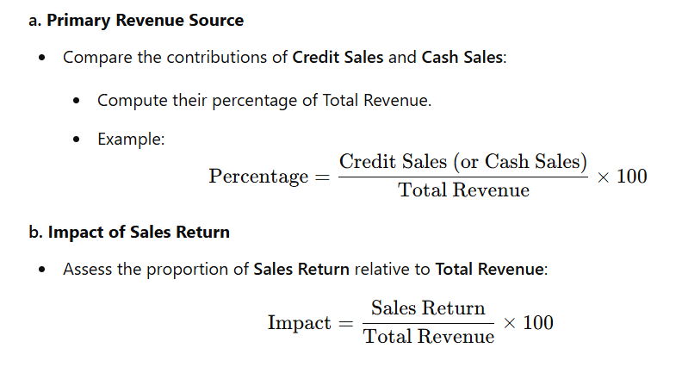
1. Revenue Analysis
Key Metrics:
Total Revenue: Sum of Credit Sales and Cash Sales (excluding sales of assets).
(Total Revenue=Credit Sales + Cash Sales)
Net Sales: Total Revenue adjusted for Sales Return (negative impact).
(Net Sales=Total Revenue−Sales Return)
Revenue Trends: Analyze how revenues fluctuate over time (month-on-month or quarter-on-quarter).
Insights:
Identify your primary revenue source: credit sales or cash sales.
Determine the effect of Sales Return on overall revenue.
Primary Revenue Source: Credit Sales contribute 60% of the Total Revenue.
Sales Return Impact: Sales Returns reduce Total Revenue by 7.5%.

Slide 6
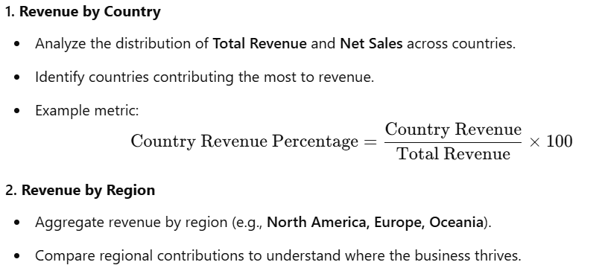
Use "Revenue Analysis" When:
The focus is broader than just sales and includes other income streams such as:
Exchange Gain/Loss
Interest Income
Dividend Income
Gain/Loss on Sale of Assets
The analysis aims to understand the overall revenue generation from all business activities.
You're calculating Total Revenue, Net Revenue, and other comprehensive financial metrics.

